Slide 1
Six Sigma Project
Redesign the Mena/French Dividends update process

Slide 2
Project Charter
Project Title: Redesign the Mena/French Dividends update process
Project Leader Name: Ilham Nicolaidou Business Unit / Location: Lipper Nicosia Project Coach: Muhan Tao | Project Team Member Automation team (Safari) in Gdynia – Krzysztof Beker Internal & External Customer Internal: Lipper Nicosia team External: Lipper data product user
Sponsor [s] Karim Naar Key Stakeholders Lipper Content, QC, QA and Safari | In Scope Mena, French, Offshore French Lipper markets Out of Scope Other Market, Other dataset
Problem Statement / ASIS Given the importance of Dividends to fund performance. Nicosia Dividends timeliness and completeness have a constant problem which affect our department QA scoreboard and clients needs. With the manual quality checking the team is managed to meet the target, however a more simplified and automated process is requested by the management and team. | Risks to Success: Fund company not sending the file in a timely matter. Constraints: Project lead may have limit effort time to spend on the project during peak
Goal Statement / TOBE A new process with less effort time required to the production and better timeliness performance.
Customer Needs Addressed: (VOC): #SR# 1-9893128504 Business Needs Addressed: (VOB): Dividends timeliness targets is not met impacting fund performance. | Estimated Phase Completion Dates Start Date: 25th Sep 2012 End Date: 25th Dec 2012

Slide 3
Process Improvement Roadmap
Define
Identify VOC
Identify Process
Measure
Translate VOC to CTQ
Measure Baseline
Analyze
Process Analysis (CTQ is Cycle Time)
Control
Improve
Set the Goal
Before / After Comparison
Produce Initial Project Charter
Update the Project Charter
Improvement Ideation
Implement
Plan to Control the Gains

Slide 4
Project Background & VOC
Dividends are added by Lipper Analyst after being provided or requested by Fund management companies, custodians or administrators. The analyst is urged to add the Dividend in a certain X dividend date translated by a drop in the Net Asset Value of the fund.
Dividends addition forecast is conducted manually, which takes much time Lipper Nicosia Tem.
For the current process, Lipper Nicosia copy the information from Email files page by page, and during Peak or holiday season in Nicosia, there may be lot of failures. Lcore Time series database presents much help to the Team to identify the missing dividends however the process to get the amount is quite long, manual process that needs to be revised.
After the release of Lcore 1.4, major improvement can be made but still historical data is not identified.
The Analyst whether will add what is available in the shared inboxes, price files, or request them, then load them manually into Lipper data base. Usually, this traditional process is not helpful to meet the new target set by QA which is as follow:
Mena: Dividend should be added within 14 business (difficult to find the data, pushy FMC, Regulator websites are not up to date)
France : 5 business day (AMF FTP )
France RT : 7 business days.
Additionally, to assure the timeliness of a record depend on 4.5 analyst covering the biggest Market in term of Mutual funds each covers more than 1800 fund. Lack of human resources and huge universe , dividends settings are not up to date all was impacting the div timeliness
In order to meet with our monthly target, an urgent need for a plan B has to be set before implementing the ultimate solution.

Slide 5
VOC/VOB
Name of Process | Voice of Business | Needs and Wants | CTQ | Target
Simplify Dividend Addition process | Lipper Nicosia Team struggled to meet timeliness target due to many factors: Big universe Vs Lack of resources. Dividend month flags for paid funds are not ticked properly. Lack of a consistent process. | Reduce the effort time of Lipper Nicosia | All Paid funds must have a dividend according to the distribution frequency within timeliness target. Ideally a dividend must be reflected in the data base as soon as the NAV is available. Div for French Funds must be added within an average of 5 days, French offshore: 7 days, Mena:14 days. | 50% Reduction of the current effort time spend adding dividend. Goal of this project is to create an easy process by automating dividend files via safari. Team won’t be spending time on looking for the data in Companies website or request.

Slide 6
Filing Patten Study
Each Analyst need to add dividends for funds which distribute according to funds under his/her ownership. Refer to table below for number of dividends for Nicosia funds each month. Using multiple source depending on in each fund management company transmission or data. Most companies doesn’t send a dividend contribution as they do with Prices/TNAs
Month | April | May | JUNE | JULY | AUGUST | SEPTEMBER | OCTOBER | NOVEMBER
Total div to add | 372 | 248 | 177 | 90 | 120 | 143 | 187 | 253

Slide 7
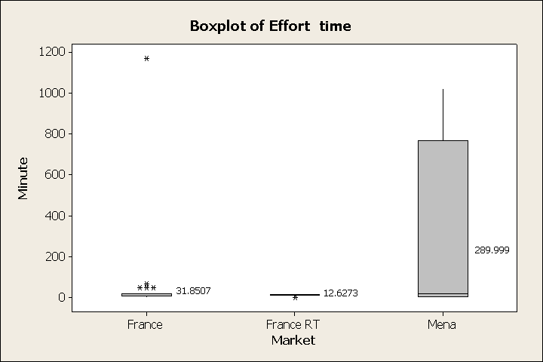
Baseline Performance
There is a big variance between different types of update for the dividend. The Average update effort time/per record is 31 min for France, 12.6 min for France RT and 290 min for Mena.

Slide 8
Timeliness Performance After Applying Internal QC
Timeliness was improved during this year thanks to an internal QC run Via L-IM in a weekly basis. Due to season holidays Lipper – Mena department failed its timeliness jumped to 26 business days.

Slide 9
Mena dividend addition is time consuming for Mena Department because of several factors:
Mena market yet need to be improved in term of providing in an organized way to publish the data into the market.
The market coverage especially GCC ( business days are Saturday-Thursday) as well is one of the factors that slightly impact the timeliness.
Companies are not very much cooperative in some Mena market as Morocco, Qatar, some FMC in UAE, Kuwait and Bahrain.
4. Exchanging emails to request a dividend takes in average 3 to 10 days .
For French Funds, AMF (French regulator) provides an up to date website and FTP feed including dividends and yet the entry of this latter requires manual effort which can be improved.
Exchanging emails to request a dividend takes in average 3 to 10 days .
For French Funds, AMF (French regulator) provides an up to date website and FTP feed including dividends and yet the entry of this latter requires manual effort which can be improved.
For Offshore funds, Finesti (Luxembourg regulator) provides only NAVs/TNAs/SOS and other type of prices but not dividends. However, the fund management companies are always sending in a timely manner their dividends via emails and still requires a manual entry.
Overall, Manual work is a common factor between the three department which impact Nicosia timeliness. Lcore is a power tool to detect funds missing dividends but still manual work is present.

Slide 10
SIPOC
Supplier | Input | Process | Output | Customers
AMF (French Regulator) | Fund files | AMF event & Fund files | Fund dividend data | Fund data user
Fund management company | Fund files | Bulk Load | Fund Dividend Data | Fund data user
Custodians | Dividend Notification | Quality check | Fund Dividend Data | Fund data user
3rd Party venders | Fund files | Save | Fund Dividend Data | Fund data user

Slide 11
ASIS Process Map - Flowchart
Effort Time
Start
Open Lcore
Open asset from missing dividend validation error
5%
Missing
No
Yes
10%
Check movement Date to confirm
Go to source
Source Available
No
70%
Send Email
Close
Put the asset on Hold
Received dividend data
Yes
Copy & Bulk load into Lcore
Re-open the asset from search
Save & Close
Update another dividend or not
No
END
15%
Yes
Go to Lcore Queue and Refresh

Slide 12
Fishbone Diagram
Process
Market Physiognomy
Lack of a Standardized process.
FMC didn’t send data
Long Effort Time to produce internal QC & Run AMF event
Long time waiting for the QC report
Bank holiday season
Market coverage for Mena & Israel
Request Received out of Officer Hour
Treating missing dividends from Lcore is time consuming.
Very Dynamic Markets
Long time waiting for Div in case of request
Delayed Div updated into ICIS
Analyst did not notice Paid fund with no flag month set
Single server location Vs natural catastrophe
Missing div was not spotted by reports and Lcore
Recruiting freeze
Global server outage
Lack of human resources
Safari queue is huge and servers are down
Analyst did not Notice Newly Assigned Requests
Long Effort Time in Updating Requests/Could not Process on Time
People
Technical Issues

Slide 13
Problem to Root Cause
Problem | Root | Solution | Task
Long Effort Time to produce internal QC, dealing with Lcore queue, AMF event, CAAM Dividend events | Manually copy the dividend From AMF Report | Replace the manual processing by automation | Design an automation tool for the team
 | Adding missing Dividends from QC report is time consuming due to multiple sources
 | Lack of a standardized process
Missing Dividends in all Lipper source. | Manually copy the information
 | Request Dividends via email time take longer
 | Manually copy the information
Market physiognomy | Reaching to the FMC in Mena region, takes longer might leads to failing to reach the targets.
 | Manually Copy the information
Requirement | Spec
Indentify all the Funds with Paid dividend Settings in the three departments. | Identify All the funds paying dividends and define their frequencies.
 | Identify the Dividend frequency.
Create an Excel Template and Email Template | Contact Fund management companies, or their data providers, third parties.
 | Explain to them how important Dividend to the fund performance while client track them in our product and how a missing dividend impact the fund's performance.
Automation | Contact all Fund companies having distributing funds. Request them to send in a timely manner and according to their dividend valuation frequency an email template with an excel file template.
 | Once this phase is completed, then Automation can be done for those emails/files by Safari Team (automation team)

Slide 14
Suggested Actions
Solutions | Action Owner | Current Status | Implementation date
Identify All the funds paying dividends and define their frequencies. Filter by Data providers. | Ilham Nicolaidou | Completed | 01/12/2013
Create a contact list of the Fund companies, data provides, third parties. Identify fund companies websites (having or requesting a web consent) in order to also create a connotate agent. | Ilham Nicolaidou | Completed | 06/12/2013
Bulk contacting Fund managing companies via emails, phone calls, meetings. | Ilham Nicolaidou | Completed | 28/02/2014
Automation with Safari | Ilham Nicolaidou & | In Progress | 28/2/2014

Slide 15
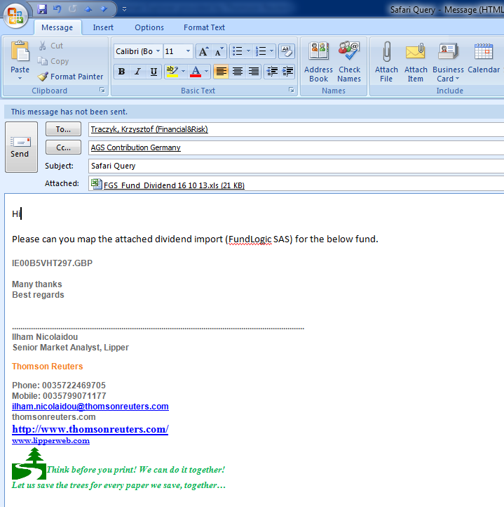

Fund Company Contact List
https://thehub.thomsonreuters.com/docs/DOC-671218

Slide 16
Fund companies List
Row Labels | No. of filings | Status
BNP Investment Part SA | 199 | done
Lyxor Int Asset Mngmnt | 166 | done
Amundi Luxembourg SA | 164 | done
AXA Funds Management | 120 | done
Amundi SA | 109 | done
Natixis AM SA | 55/101 | done
La Banque Postale AM | 100 | done
BNP Paribas AM SAS | 92 | done
Aviva Investors France | 86 | done
Natixis Glbl Asset Mgmt | 70 | done
AXA IM Paris SA | 61 | done
Edmond de Rothschild AM | 58 | done
CM-CIC AM | 57 | done
Groupama AM SA | 5/43 | done
Covea Finance SAS | 33 | done
Allianz GI France SA | 32 | In progress
CPR Asset Management SA | 32 | done
Amdi Private Eq Fds SA | 26 | done
Neuflize | 20 | In progress
CA Indosuez Gestion | 20 | done
Finesti | 821 | Approved and completed
ASFIM | 47 | Div history loding in progress

Slide 17
Design Details
Dividend timeliness project, help 50% of funds under Nicosia department to improve in comparison to 6 months ago. In Feb 2013, a dividend is added in 16 days for Mena, 10 for France and 9.10 days in France RT ; in Feb 2014 (Not yet available)
I conducted a dividend setting clean up for the whole universe which required to apply the month flag and correct the dividend setting under corporate action in ICIS (Lipper Data Base). The Latter helped identifying the main problem causing timeliness issues. If a Mutual fund is paying dividends in certain month, if the appropriate month is not added in the data base the dividend will remain missing as the Quality check macro relies on that data. In some scenarios we receive the dividend very late and the addition is manual.
Another major clean up consists of the convenience share classes affecting as well timeliness, 200 convenience in total under Lipper Nicosia.
Fund companies doesn’t provide multi currency dividend amounts (issue is posted in methodology clinic to find a solution) Already 2 possible options will be suggested:
1- Use Reuters exchange rates (if a client wants to calculate the performance of the conv share class, the result will be very different from the main class because of missing dividends).
2- Exclude them from the dividend by disabling Total Return calculations for conv shares classes on our products
clients will be able to calculate only Capital return .
After the clean up, in the second phase I focused on identifying which funds distribute often than others like the monthly ones (Money market funds with NAV = 1, MD class…) meanwhile I kept good control on keeping timeliness low by running a weekly QC file until implementing a permanent solution.
In the third phase, I filtered Top priority companies which manage the biggest number of distributing funds. Then I moved to last phase which the implementation of the solution which is automating dividend loading with Safari Team leaded by Krzysztof Beker.
Before Dec 2013, it was critical to automate dividend, as most of times the Fund management companies doesn’t provide us with the exact X Dividend date (XD) . This latter should match with A Net Asset Value movement. Thanks to Lcore hot fix 1.3 this database is now able to spot a dividend distribution which is not falling in the XD, which made automation possible.
I have reached out to all top 1 priority Fund management companies or their data provider, and request them kindly to align their dividend contribution to our new process called Nicosia Master dividend sent to our common inbox france.lipper@thomsonreuters.com

Slide 18
Design Details
The project helped improving the timeliness to 50% of the universe. In order to reach our monthly QA metric target, analyst are invited to use the following process:
1 – Existing funds: request FMCs to adopt the Master dividend process, by sending the following Email Template.
2- If the company reply is positive the next step is to notify safari Team for automation with a Safari Query as follow:

Slide 19
Design Details
I would like to introduce this process and align it along with Lipper methodology. Safari will be notified about the Master Dividend process so the Analyst will only provide the domain address of the fund company to Safari to add the FMC to the import without sending the mapping every time.
The benefit :
Reduce effort time from minutes to minute per day. (Need baseline figures)
Improve Accuracy.
Improve timeliness.
Avoid missing data.
Analyst will focus on other key task.

Slide 20
Pilot Schedule
Name of Pilot | Dividend process Automation
Where? | From France.Lipper@thomsonreuters.com to SAFARI to Lcore.
When? | From 1st Jan to 31 March
How? | Email and Excel file Template automation to replace manual work. Process will be called Master dividend.

Slide 21
ASIS vs TOBE Process Map
Start
Effort Time
Open Lcore
Wrong dividend date
2%
Correct
Yes
Override
10%
No
Change the XD date to movement date
Save & Close
Go to Lcore Queue and Refresh
END
2%

Slide 22
Pilot Result
Raw Data
Department | ACCT Metrics | Data Element | Q1 | Q2 | Q3 | Q4 | January | February | March | April | May | June | July | August | September | October | November | December | YTD Average
Nicosia - MENA | Timeliness | Dividends | 15.00 | 15.00 | 15.00 | 15.00 | 11.37 | 15.19 | 13.20 | 11.37 | 11.54 | 7.58 | 9.88 | 6.56 | 23.28 | 12.89 | 13.22 | 8.84 | 12.08
Nicosia - France | Timeliness | Dividends | 7.00 | 7.00 | 7.00 | 7.00 | 6.16 | 9.83 | 5.20 | 5.18 | 3.73 | 4.48 | 5.15 | 2.40 | 3.85 | 4.77 | 3.87 | 5.01 | 4.97
Nicosia - France RT | Timeliness | Dividends | 14.00 | 14.00 | 14.00 | 14.00 | 17.11 | 9.10 | 10.21 | 7.61 | 4.80 | 10.36 | 10.19 | 8.15 | 5.58 | 4.79 | 6.64 | 7.51 | 8.50

Slide 23
Summary

